Slide 1


3D Surface Reconstruction by Pointillism
Olivia Wiles Andrew Zisserman

Slide 2
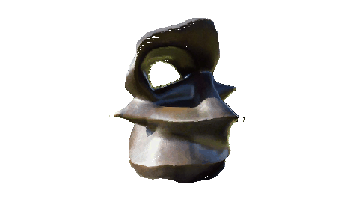
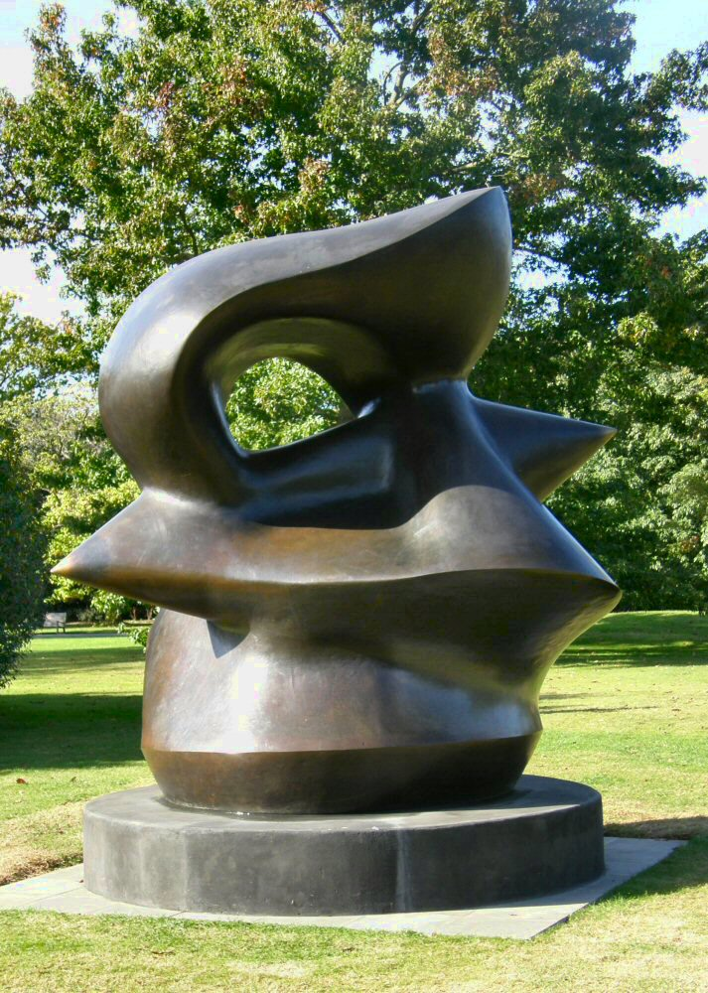
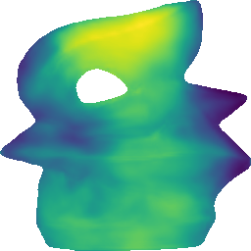
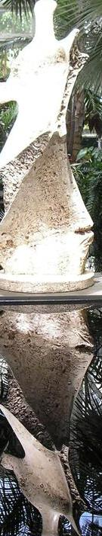
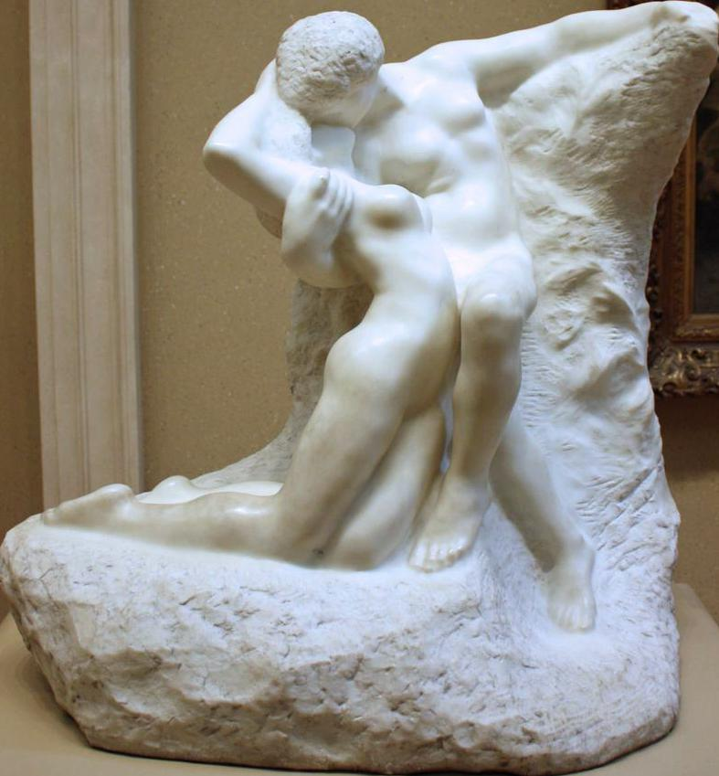
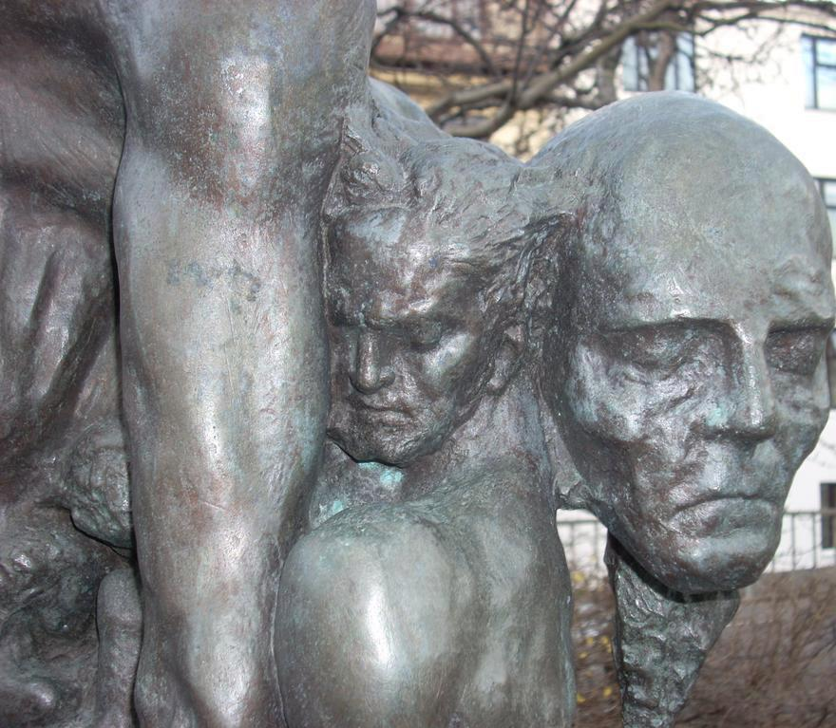
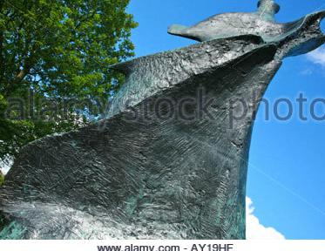
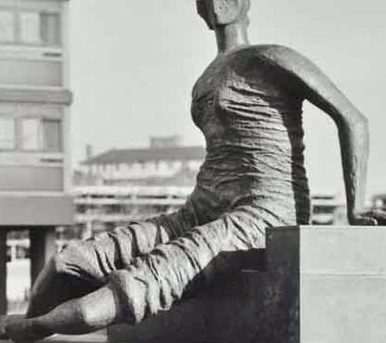
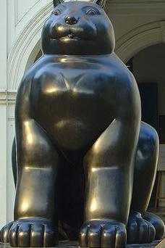
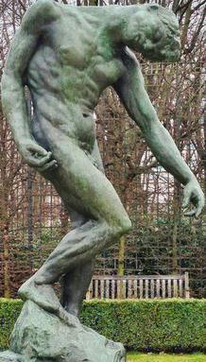
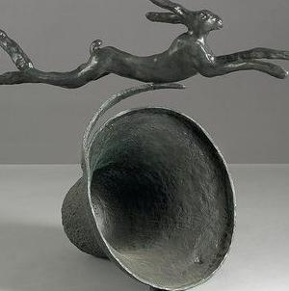
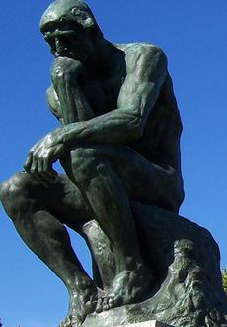
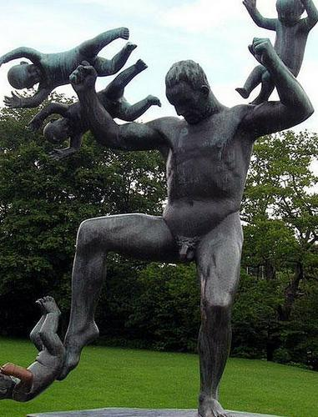
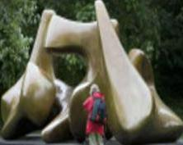
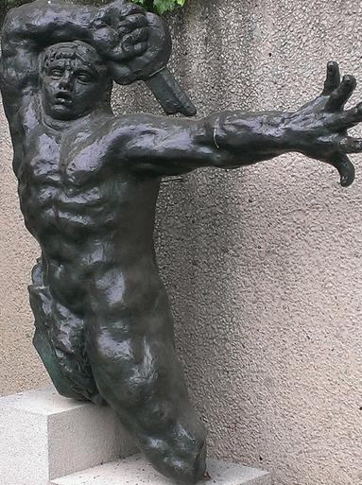
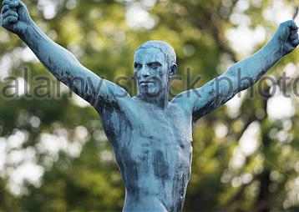
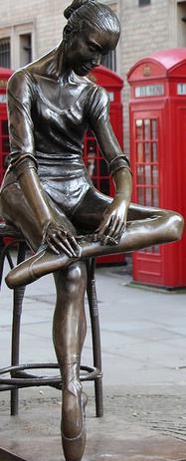
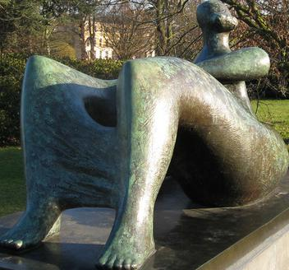
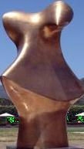
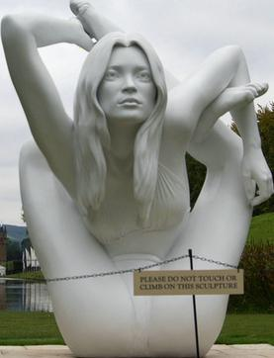
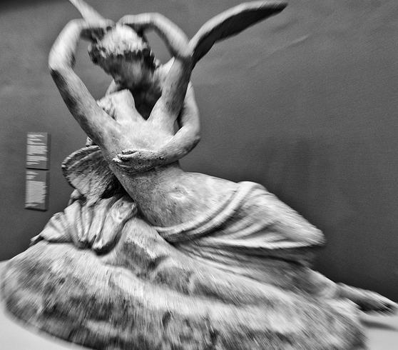
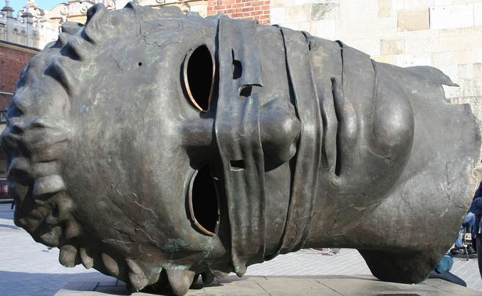
Objective
LiftNet
Notes:
Objective: given a single image to be able to infer the depth of the object from which we can render new views.
Question: who knows what this sculpture is? The artist/name?
Yet I'd argue that you have a pretty strong impression as to the 3D: e.g. where the edges are, where it is nearer, the self shadow without having seen the sculpture before. So maybe we should aim at making use of those cues that are more general, e.g. lighting.

Slide 3
Objective
LiftNet
Use sculptures as objects due to their great variety of shape:
Use only real images for training
No direct supervision on depth
Notes:
Make use of objects due to their great variety of shape (not focusing on a particular object class) and use only real images for training.
We aren't going to require any supervision on depth because frankly it is hard to attain a large dataset of ground truth depth for these varied and complex sculptures in many different domains.

Slide 4
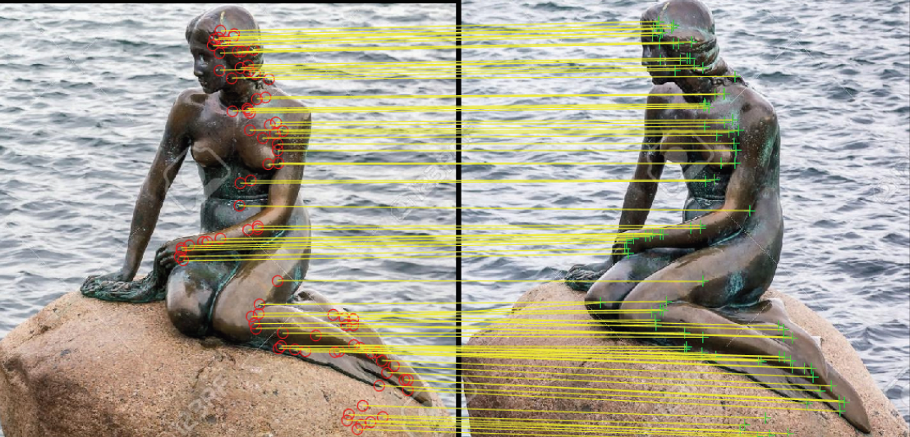
Geometry of correspondences
Two paths to obtain correspondences across views:
1. Use two-view geometric relations
view 1
view 2
Robust estimation of SIFT correspondences
Use epipolar geometry
Does not require 3D structure or cameras
Notes:
To do this we're going to make use of correspondences which we're going to use to impose constraints on the depth predicted by a nn.
I'll first describe the basic, underlying idea followed by how we're going to leverage it in a learning framework.

Slide 5
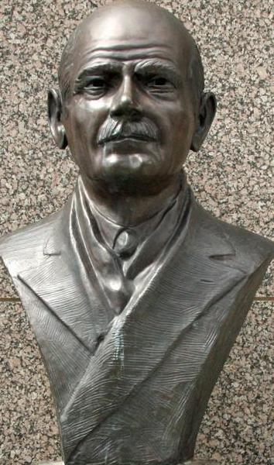
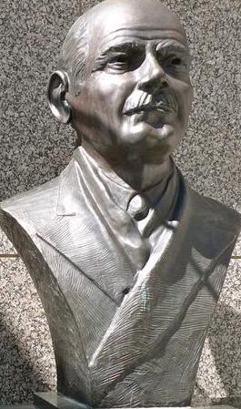
Geometry of correspondences
Two paths to obtain correspondences across views:
1. Use two-view geometric relations
2. Use 3D structure and re-projection
P
view 1
view 2
view 1
view 2
Robust estimation of SIFT correspondences
Use epipolar geometry
Does not require 3D structure or cameras
Compute 3D points in view 1
Project (with camera P) 3D points into view 2
Requires 3D structure and cameras

Slide 6
Training objective
Use both paths for training:
Source Frame
Target Frame
x_{i}^{t}
x_{i}^{s}
Source Frame
Target Frame
Correspondences from epipolar geometry (treat as ground truth)

Slide 7
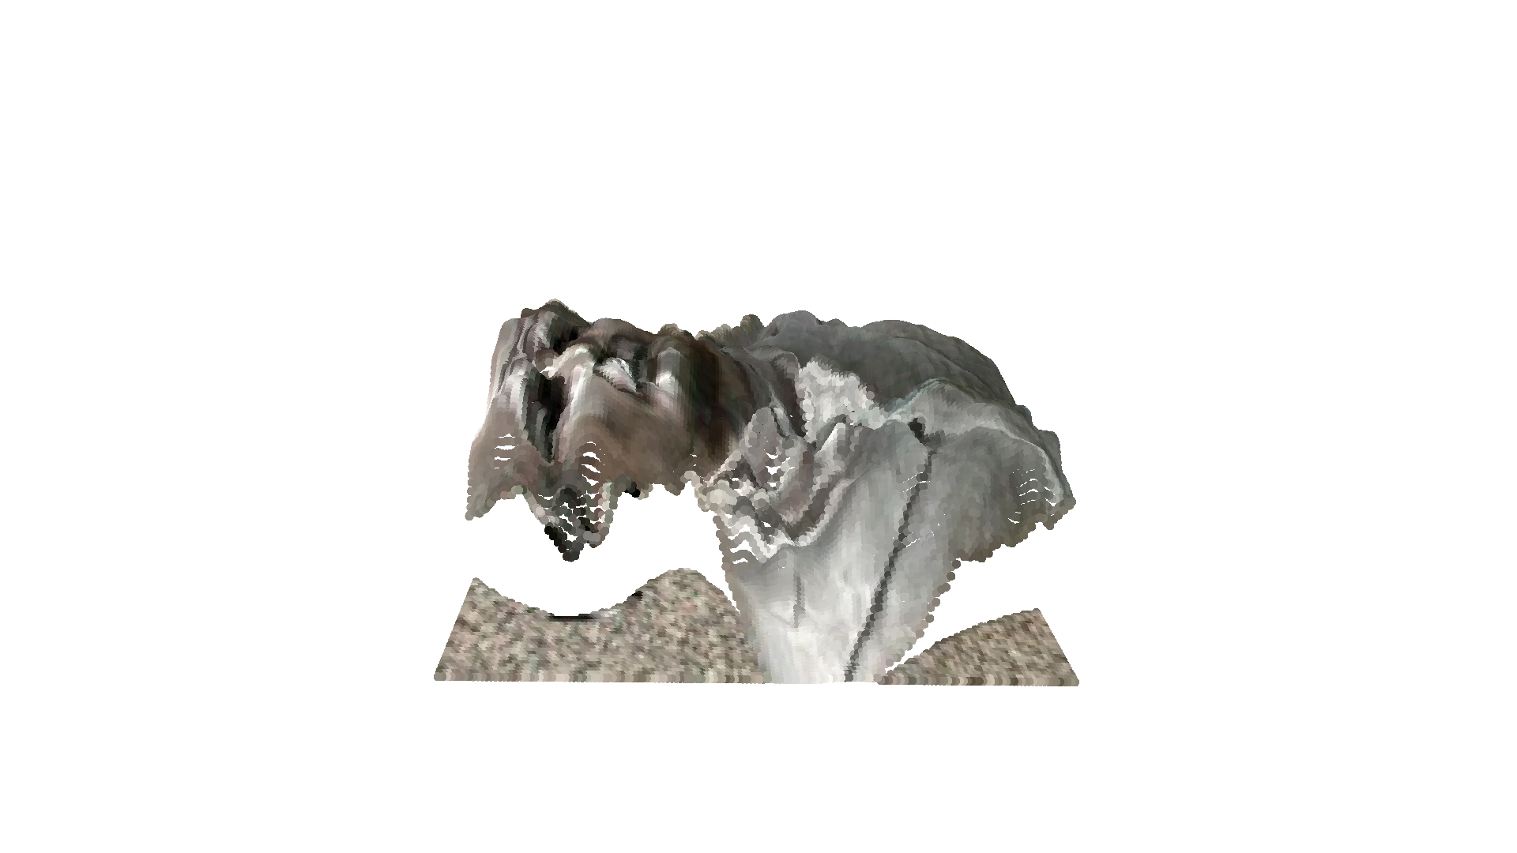
Training objective
Use both paths for training:
X_{i}
Network predicts depth
Source Frame
Target Frame
x_{i}^{t}
x_{i}^{s}
Source Frame
Target Frame
Correspondences from epipolar geometry (treat as ground truth)
Notes:
Use a binary cross entropy loss over pixels (i indexes over pixels).
This gives the two tasks : silhouette prediction at a new view and depth prediction at the given views.

Slide 8
Training objective
Use both paths for training:
X_{i}
P
Source Frame
Target Frame
Network predicts depth
x_{i}^{t}
x_{i}^{s}
Source Frame
Target Frame
Correspondences from epipolar geometry (treat as ground truth)
Correspondences by inferring depth (by the network) and re-projection
Notes:
Use a binary cross entropy loss over pixels (i indexes over pixels).
This gives the two tasks : silhouette prediction at a new view and depth prediction at the given views.

Slide 9
Training objective
Use both paths for training:
X_{i}
P
Source Frame
Target Frame
Network predicts depth
x_{i}^{t}
x_{i}^{s}
Source Frame
Target Frame
Correspondences from epipolar geometry (treat as ground truth)
Correspondences by inferring depth (by the network) and re-projection
Training objective from re-projection error
Notes:
Use a binary cross entropy loss over pixels (i indexes over pixels).
This gives the two tasks : silhouette prediction at a new view and depth prediction at the given views.

Slide 10
Training objective
Use both paths for training:
X_{i}
P
Source Frame
Target Frame
Network predicts depth
x_{i}^{t}
x_{i}^{s}
Re-projection error
Source Frame
Target Frame
Correspondences from epipolar geometry (treat as ground truth)
Correspondences by inferring depth (by the network) and re-projection
Training objective from re-projection error
Notes:
Use a binary cross entropy loss over pixels (i indexes over pixels). i.e. use multiple views (which we know works well, and automatically) to generate training data
This gives the two tasks : silhouette prediction at a new view and depth prediction at the given views.

Slide 11
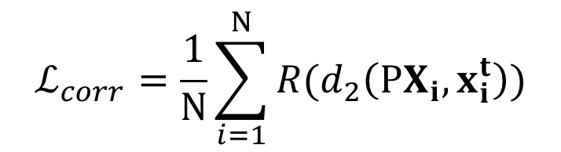
Training objective
Use both paths for training:
X_{i}
P
Source Frame
Target Frame
Network predicts depth
x_{i}^{t}
x_{i}^{s}
Re-projection error
$$ℒ_{corr}=\frac{1}{N}\sum_{i=1}^{N}{R(d_{2}\left(PX_{i},x_{i}^{t}\right))}$$
Source Frame
Target Frame
Correspondences from epipolar geometry (treat as ground truth)
Correspondences by inferring depth (by the network) and re-projection
Training objective from re-projection error
Notes:
Use a binary cross entropy loss over pixels (i indexes over pixels). i.e. use multiple views (which we know works well, and automatically) to generate training data
This gives the two tasks : silhouette prediction at a new view and depth prediction at the given views.

Slide 12
Training objective
Use both paths for training:
X_{i}
P
Source Frame
Target Frame
Network predicts depth
x_{i}^{t}
x_{i}^{s}
Re-projection error
$$ℒ_{corr}=\frac{1}{N}\sum_{i=1}^{N}{R(d_{2}\left(PX_{i},x_{i}^{t}\right))}$$
Source Frame
Target Frame
Correspondences from epipolar geometry (treat as ground truth)
Correspondences by inferring depth (by the network) and re-projection
Training objective from re-projection error
Cycle Consistency!
Notes:
This is a form of cycle consistency: we know one part of the cycle (the 2D) and use this to constrain the second part: source → depth.

Slide 13
Testing
X_{i}
Network predicts depth
Source Frame
Use only the depth prediction at test time.
Notes:
Use a binary cross entropy loss over pixels (i indexes over pixels). i.e. use multiple views (which we know works well, and automatically) to generate training data
This gives the two tasks : silhouette prediction at a new view and depth prediction at the given views.

Slide 14
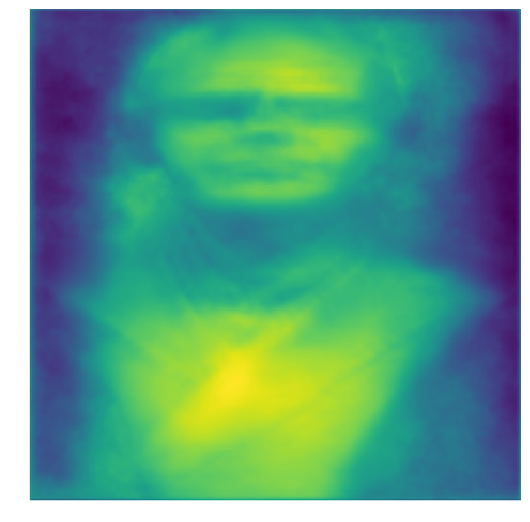
Testing
X_{i}
Network predicts depth
LiftNet U-Net architecture
Source Frame
Use only the depth prediction at test time.
Notes:
Use a binary cross entropy loss over pixels (i indexes over pixels). i.e. use multiple views (which we know works well, and automatically) to generate training data
This gives the two tasks : silhouette prediction at a new view and depth prediction at the given views.

Slide 15
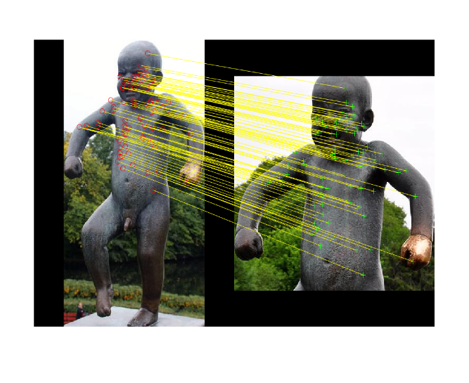
Key Idea
Task network with generating a dense depth map
“Learning from Pointillism”
A particular view pair only provides sparse constraints at points of correspondences
Notes:
So one view may constrain certain parts and another a different part of the sculpture, but network must do this for *all* these examples over the course of training.
For example the face of the boy may be constrained by one view but this view will be constrained by other views which may constrain the arms or legs etc.

Slide 16
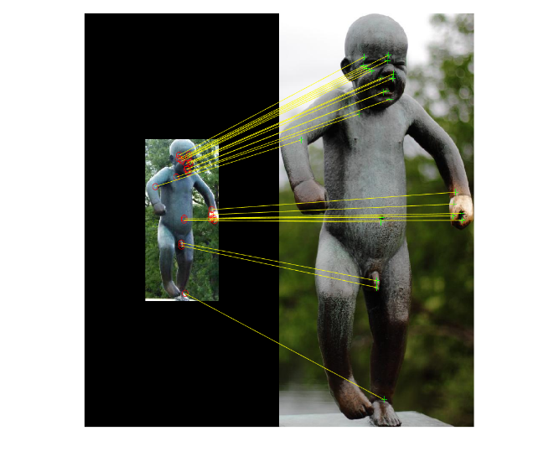
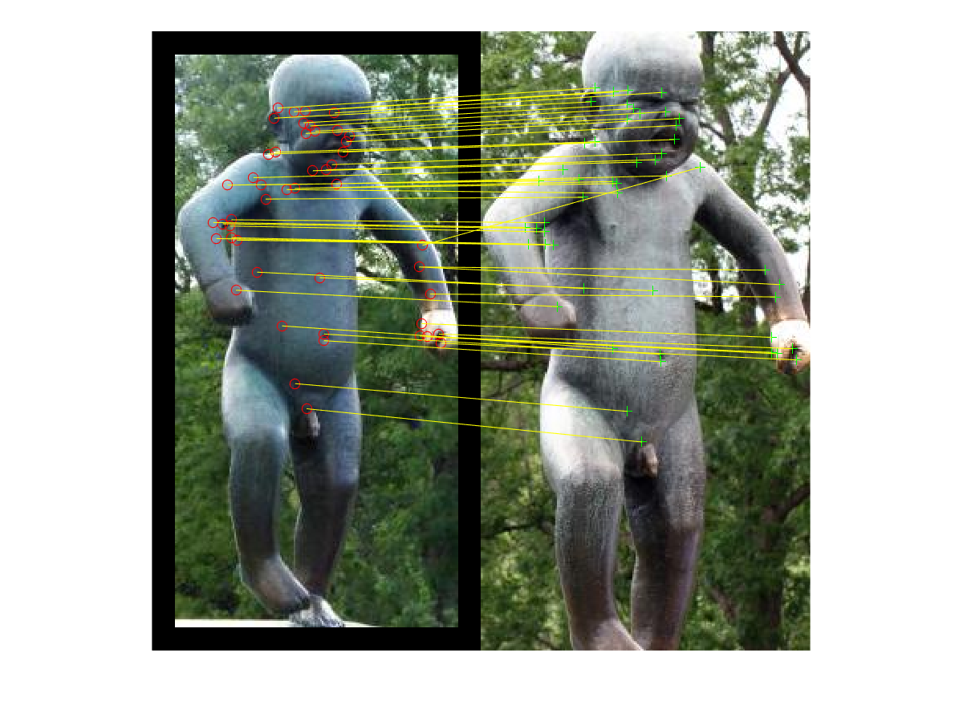
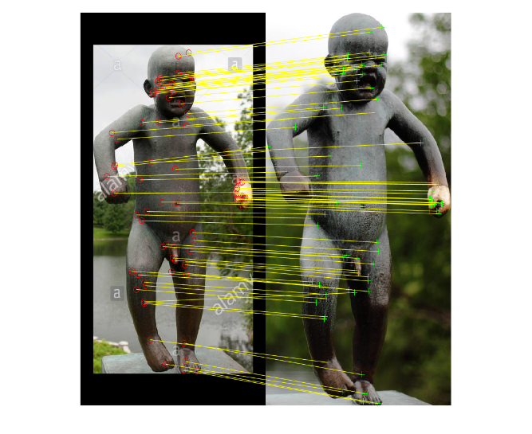
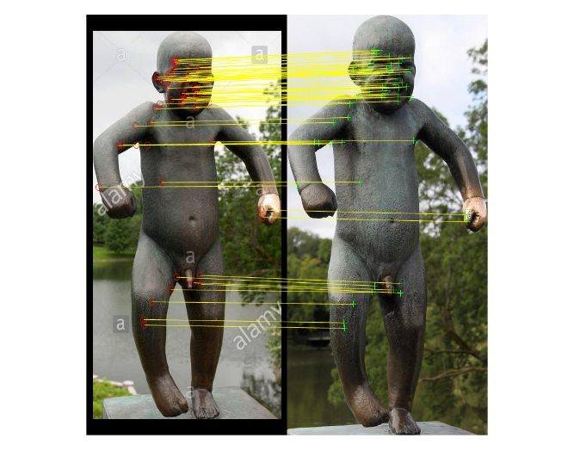
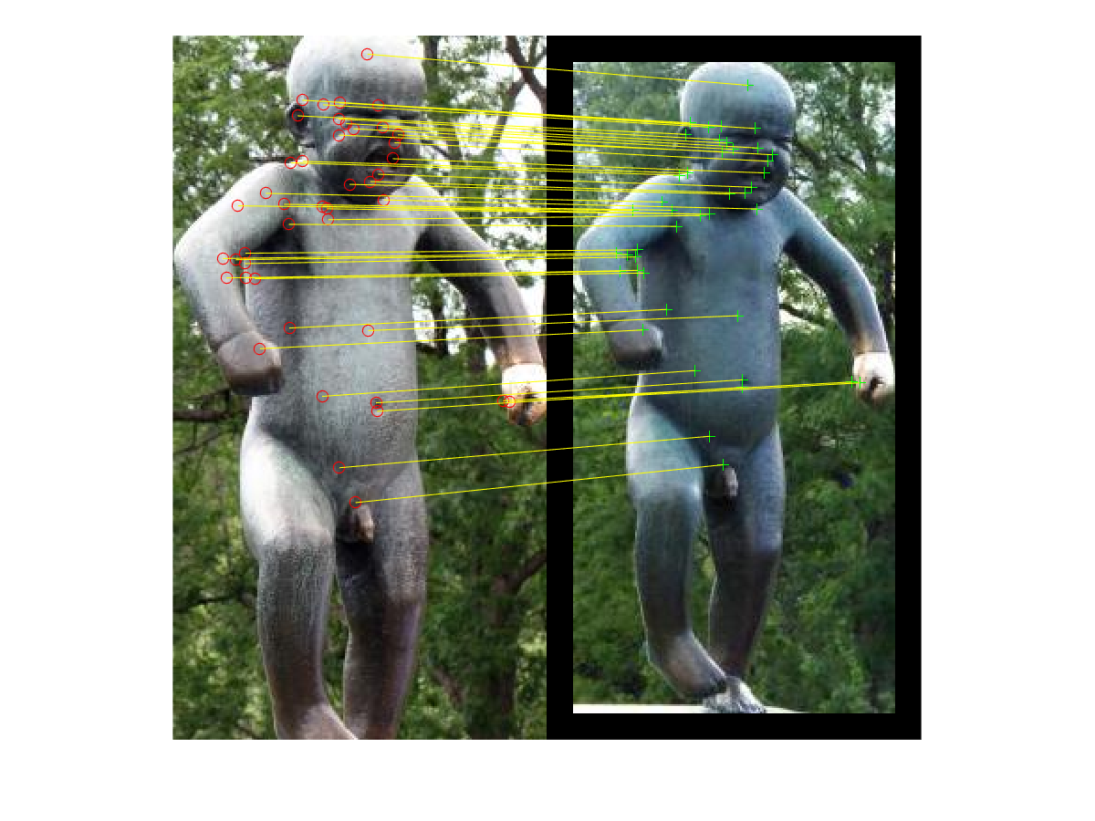
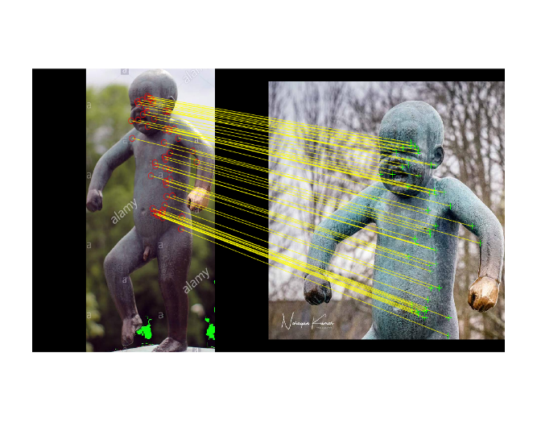
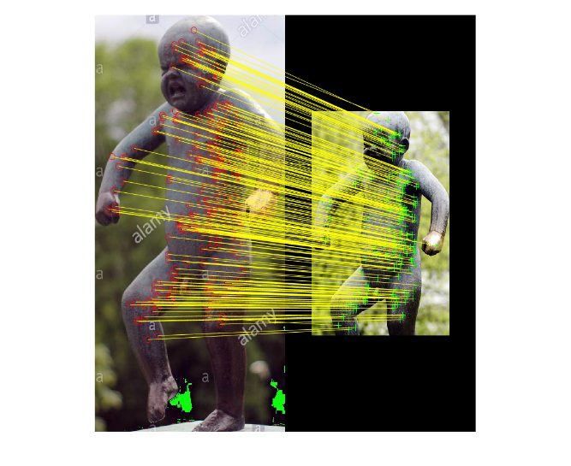
Key Idea
Task network with generating a dense depth map
“Learning from Pointillism”
A particular view pair only provides sparse constraints at points of correspondences
But, the network must predict dense map for all view pairs
Notes:
So one view may constrain certain parts and another a different part, e.g. the left and right part of the body may be constrained by different views.
And we have many examples of the same sculpture.

Slide 17
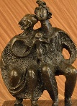
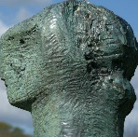
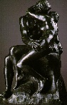
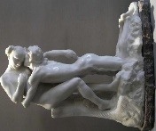
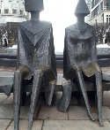
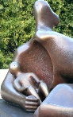
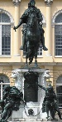
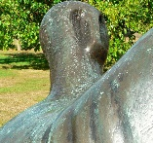
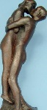
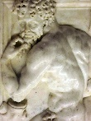
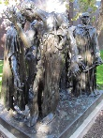
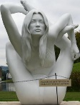
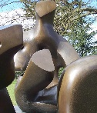
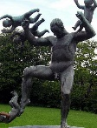
























Key Idea
Task network with generating a dense depth map
“Learning from Pointillism”
A particular view pair only provides sparse constraints at points of correspondences
But, the network must predict dense map for all view pairs and all sculptures in the training dataset (1000 different sculptures, 170k view pairs, 30M correspondences)
Notes:
And then additionally it must do this across many instances.

Slide 18
Key Idea
Task network with generating a dense depth map
“Learning from Pointillism”
A particular view pair only provides sparse constraints at points of correspondences
But, the network must predict dense map for all view pairs and all sculptures in the training dataset (1000 different sculptures, 170k view pairs, 30M correspondences)
Only way the network can accomplish this is if the dense depth map is correct for any sculpture
Notes:
As a result it builds up a dense depth.

Slide 19


Pointillism
⇒ “a technique of painting in which small, distinct dots of colour are applied in patterns to form an image.”
Georges Seurat (1859–1891)
https://www.deviantart.com/sweetgeminimb/art/Lion-Pointillism-569127853
Related work on real data:
Tinghui Zhou, Matthew Brown, Noah Snavely, and David G. Lowe. "Unsupervised learning of depth and ego-motion from video." CVPR, 2017.
David Novotny, Diane Larlus, and Andrea Vedaldi. "Learning 3d object categories by looking around them." ICCV, 2017.
Zhengqi Li and Noah Snavely. "MegaDepth: Learning Single-View Depth Prediction from Internet Photos." CVPR, 2018.
Notes:
Why pointillism?

Slide 20
Training objective
Use both paths for training:
X_{i}
P
Source Frame
Target Frame
Network predicts depth
x_{i}^{t}
x_{i}^{s}
Re-projection error
$$ℒ_{corr}=\frac{1}{N}\sum_{i=1}^{N}{R(d_{2}\left(PX_{i},x_{i}^{t}\right))}$$
Source Frame
Target Frame
Correspondences from epipolar geometry (treat as ground truth)
Correspondences by inferring depth (by the network) and re-projection
Training objective from re-projection error
Notes:
Now that we have a good idea (I hope) of the basic idea, I’m going to fill in some of the details.

Slide 21
Implementation details
Use both paths for training:
X_{i}
1
P
Source Frame
Target Frame
Network predicts depth
x_{i}^{t}
x_{i}^{s}
Re-projection error
$$ℒ_{corr}=\frac{1}{N}\sum_{i=1}^{N}{R(d_{2}\left(PX_{i},x_{i}^{t}\right))}$$
Source Frame
Target Frame
Correspondences from epipolar geometry (treat as ground truth)
Correspondences by inferring depth (by the network) and re-projection
Training objective from re-projection error
Notes:
1. Camera

Slide 22
Implementation details
Use both paths for training:
X_{i}
1
P
Source Frame
Target Frame
Network predicts depth
x_{i}^{t}
x_{i}^{s}
Re-projection error
$$ℒ_{corr}=\frac{1}{N}\sum_{i=1}^{N}{R(d_{2}\left(PX_{i},x_{i}^{t}\right))}$$
Source Frame
Target Frame
2
Correspondences from epipolar geometry (treat as ground truth)
Correspondences by inferring depth (by the network) and re-projection
Training objective from re-projection error
Notes:
2. Robustness term

Slide 23
Implementation details
Use both paths for training:
X_{i}
1
P
Source Frame
Target Frame
Network predicts depth
x_{i}^{t}
x_{i}^{s}
Re-projection error
3
$$ℒ_{corr}=\frac{1}{N}\sum_{i=1}^{N}{R(d_{2}\left(PX_{i},x_{i}^{t}\right))}$$
Source Frame
Target Frame
2
Correspondences from epipolar geometry (treat as ground truth)
Correspondences by inferring depth (by the network) and re-projection
Training objective from re-projection error
Notes:
3. Our method of obtaining these correspondences, i.e. the dataset

Slide 24



1. The camera
$x_{i}^{t}=P X_{i}$ : $X_{i}={\left[x_{i}^{s},y_{i}^{s}, d_{i}, 1\right]}^{T}$
X_{i}
P
x_{i}^{s}
x_{i}^{t}
Source view
Target view
Notes:
We have these correspondences and we want to determine the camera to project the predicted depth into the target view.
There are many ways we could have done this but here we’re going to compute the optimal camera for the given depth <→ target mapping.

Slide 25

1. The camera
$x_{i}^{t}=P X_{i}$ : $X_{i}={\left[x_{i}^{s},y_{i}^{s}, d_{i}, 1\right]}^{T}$
$\left[\begin{matrix}x_{1}^{t} & … & x_{N}^{t}\end{matrix}\right]=P \left[\begin{matrix}X_{1} & … & X_{N}\end{matrix}\right]$
$x=PX$
X_{i}
P
x_{i}^{s}
x_{i}^{t}
Source view
Target view
Notes:
And as we’ll have many for a pair of views, this will give a system of equations.
This computation is dependent on the depth, so we want the derivative of the camera with respect to the predicted depth.

Slide 26

1. The camera
$x_{i}^{t}=P X_{i}$ : $X_{i}={\left[x_{i}^{s},y_{i}^{s}, d_{i}, 1\right]}^{T}$
$\left[\begin{matrix}x_{1}^{t} & … & x_{N}^{t}\end{matrix}\right]=P \left[\begin{matrix}X_{1} & … & X_{N}\end{matrix}\right]$
$x=PX$
$x^{T}=X^{T}P^{T}$
${\left(X^{T}\right)}^{+}x^{T}≈{{\left(X^{T}\right)}^{+}X}^{T}P^{T}≈P^{T}$
$\left(VΣ^{+}U^{T}\right)x^{T}=P^{T}$ : $UΣV^{T}$ = $X^{T}$
X_{i}
P
→ Use the SVD to rewrite$P$ in terms of $X,x$.
x_{i}^{s}
x_{i}^{t}
Source view
Target view
Multiple View Geometry in Computer Vision Second Edition.
Richard Hartley and Andrew Zisserman, Cambridge University Press, March 2004.
Notes:
To do this we’ll use a simple trick: just rewrite the equation such that the camera is an explicit function of the depth Xi and correspondence x by using the SVD.
There are then multiple ways to take the derivative with respect to the SVD, we’ll just use the one given in the library (we use pytorch).
Then because each step is differentiable, we can differentiate through this computation.

Slide 27



2. A robust cost function
$$ℒ_{corr}=\frac{1}{N}\sum_{i=1}^{N}{R(d_{2}\left(PX_{i},x_{i}^{t}\right))}$$
$$R= \left\{\begin{aligned}\frac{1}{2}x^{2}\left(1 − \frac{x^{2}}{2τ^{2}}\right), :if x^{2} ≤τ^{2} \\ \frac{τ^{2}}{4} , :otherwise\end{aligned}\right.$$
Notes:
Going to have outliers from inaccurate correspondences: going to use a robust loss weighting.
x is the distance : so x^2 is the MSE.
Tau is 10 pixels in practice.

Slide 28
3. Obtaining the dataset
 | Train | Val | Test | All
# Artists | 138 | 7 | 1 | 143
# Works | 1031 | 27 | 129 | 1187
Table: Dataset statistics for the Sculpture dataset. ~30 M correspondences.
Notes:
Artists are divided into works and the works are where we get view-pairs/correspondences from.

Slide 29
Extracting correspondences
Step I: Extract correspondences:
Find and match feature descriptors
Step II: Clean correspondences:
Robust estimation of epipolar geometry using SIFT correspondences
Reject view pairs related by planar homography
Notes:
Extracting correspondences will proceed in two steps:
Find and matching descriptors
Cleaning correspondences of which the following are two examples:
E.g. use epipolar geometry to remove inaccurate ones
Rejecting ones that can be related by a planar homography because these could simply be described by a plane and so enforce no constraint on the 3D surface.

Slide 30








Example correspondences
Robust estimation of epipolar geometry using SIFT correspondences
Reject view pairs related by planar homography
Notes:
Take a large collection of images, divided at the artist level.
Extract clusters, where clusters contain the same sculpture at similar viewpoints
Within a cluster, extract correspondences between views

Slide 31
Example correspondences
Robust estimation of epipolar geometry using SIFT correspondences
Reject view pairs related by planar homography
Notes:
Take a large collection of images, divided at the artist level.
Extract clusters, where clusters contain the same sculpture at similar viewpoints
Within a cluster, extract correspondences between views

Slide 32








Example correspondences
Robust estimation of epipolar geometry using SIFT correspondences
Reject view pairs related by planar homography
Notes:
Take a large collection of images, divided at the artist level.
Extract clusters, where clusters contain the same sculpture at similar viewpoints
Within a cluster, extract correspondences between views

Slide 33
Dataset statistics
 | Train | Val | Test | All
# Artists | 138 | 7 | 1 | 143
# Works | 1031 | 27 | 129 | 1187
# Matching pairs | 168726 | 552 | 13166 | 182K
Avg # correspondences per pair | 181 | 223 | 174 | 181
Table: Dataset statistics for the Sculpture dataset. ~30 M correspondences.

Slide 34












Qualitative results
Input image
LiftNet
Notes:
You notice that the depth is pretty sharp.
Presumably because we have no explicit smoothness regularizer

Slide 35






Qualitative results
Input image
LiftNet

Slide 36












Qualitative results
Input image
LiftNet

Slide 37






Qualitative results
Input image
LiftNet

Slide 38
Experiments
Trained on ShapeNet
Trained on the Sculpture dataset
Evaluated on real sculptures
Generalisation capabilities evaluated on synthetic sculptures
Notes:
ShapeNet will be used to validate whether the sparse correspondences has a positive affect.
Then we’ll evaluate by training and testing on real objects, an example of which is shown bottom

Slide 39

1. ShapeNet
Setup:
For each pair of images randomly select, and fix 50 correspondences
Use these as the ground truth correspondences for training LiftNet ($ℒ_{corr}$)
Baseline:
Train the same network using an L1 loss on the ground truth depth, allowing for a translation and scaling in depth
Evaluation:
Normalise the depth prediction, allowing for a translation and scaling in depth
Notes:
Why? We can’t be sure as to absolute depth – it is inherently ambiguous, so we will take this into account on evaluation.
As a result, we want the baseline to be comparable and so take this into account in the loss.

Slide 40












Qualitative results
Input Image
LiftNet’s predicted depth
Ground truth depth

Slide 41
Quantitative results
Notes:
Perhaps surprising: results are comparable and so LiftNet

Slide 42
Experiments
Trained on ShapeNet
Trained on the Sculpture dataset
Evaluated on real sculptures
Generalisation capabilities evaluated on synthetic sculptures
Notes:
ShapeNet will be used to validate whether the sparse correspondences has a positive affect.
Then we’ll evaluate by training and testing on real objects, an example of which is shown bottom

Slide 43






Quantitative results
Going to evaluate on a small collection of real objects:
 | # of objects | # of images
Evaluation Sculpture Dataset | 11 | 208
Table: Dataset statistics for the evaluation dataset.
Notes:
Going to predict depth for the foreground objects. Showing original image, mask, and ground truth depth.
Error is only evaluated for the part that is predicted as foreground.

Slide 44
Quantitative results
Setup:
Use LiftNet trained on the sculpture dataset
Baselines:
COLMAP: The same architecture trained to regress depth, which is collected using a standard SfM pipeline
Zhou et al: A self-supervised approach using a photometric loss
Chen et al: A supervised model trained to predict ordinal depth
Evaluation:
Normalise the depth prediction by a scaling factor in depth
Zhou, Tinghui, et al. "Unsupervised learning of depth and ego-motion from video." CVPR. 2017.
Schonberger, Johannes L., and Jan-Michael Frahm. "Structure-from-motion revisited." CVPR. 2016.
Chen, Weifeng, et al. "Single-image depth perception in the wild." NIPS. 2016.
Notes:
Going to predict depth for the foreground objects. Showing original image, mask, and ground truth depth.
Error is only evaluated for the part that is predicted as foreground.

Slide 45
Quantitative results
Supervised
Self-Supervised
Ours
Supervised
Self-Supervised
Ours
Zhou, Tinghui, et al. "Unsupervised learning of depth and ego-motion from video." CVPR. 2017.
Schonberger, Johannes L., and Jan-Michael Frahm. "Structure-from-motion revisited." CVPR. 2016.
Chen, Weifeng, et al. "Single-image depth perception in the wild." NIPS. 2016.
Notes:
Relative: normalise by true value.

Slide 46
Quantitative results
Supervised
Self-Supervised
Ours
Supervised
Self-Supervised
Ours
Zhou, Tinghui, et al. "Unsupervised learning of depth and ego-motion from video." CVPR. 2017.
Schonberger, Johannes L., and Jan-Michael Frahm. "Structure-from-motion revisited." CVPR. 2016.
Chen, Weifeng, et al. "Single-image depth perception in the wild." NIPS. 2016.
Notes:
Relative: normalise by true value.

Slide 47
Experiments
Trained on ShapeNet
Trained on the Sculpture dataset
Evaluated on real sculptures
Generalisation capabilities evaluated on synthetic sculptures
Notes:
ShapeNet will be used to validate whether the sparse correspondences has a positive affect.
Then we’ll evaluate by training and testing on real objects, an example of which is shown bottom

Slide 48








Generalisation capability
Input Images:
LiftNet’s Prediction:
Notes:
Relative: normalise by true value.

Slide 49




Generalisation capability
Input Images:
LiftNet’s Prediction:
Notes:
Relative: normalise by true value.

Slide 50
Quantitative results
Supervised
Self-Supervised
Ours
Supervised
Self-Supervised
Ours
Zhou, Tinghui, et al. "Unsupervised learning of depth and ego-motion from video." CVPR. 2017.
Schonberger, Johannes L., and Jan-Michael Frahm. "Structure-from-motion revisited." CVPR. 2016.
Chen, Weifeng, et al. "Single-image depth perception in the wild." Advances in Neural Information Processing Systems. 2016.
Notes:
Relative: normalise by true value.

Slide 51
Conclusions
Shown:
Use MVG to extract sparse correspondences and use this to train a dense depth predictor
Learn this end-to-end, including differentiating through the camera
Future work:
To leverage additional, traditional constraints within this framework
To generalise the camera (e.g. ordinal depth)

Slide 52










Thank you!

